Slide 1
Federal Market / Grant Services overview

Slide 2
FEDERAL MARKET OVERVIEW
SWCA Provides:
NEPA Services
Natural/Cultural Resource Studies
Permitting and Compliance
Environmental Engineering
Resilience Planning
Public Engagement
Ecological Restoration

Slide 3
Need Funding? We Can Help!
We have extensive experience preparing successful federal grant applications.
We will help you develop high quality, technically sound proposals for your high-priority projects!

Slide 4
SWCA Knows Grants!
We have been working on grant-funded projects since our company’s inception
Frequent partners include:
Non-Profits
Tribes
Public Agencies

Slide 5
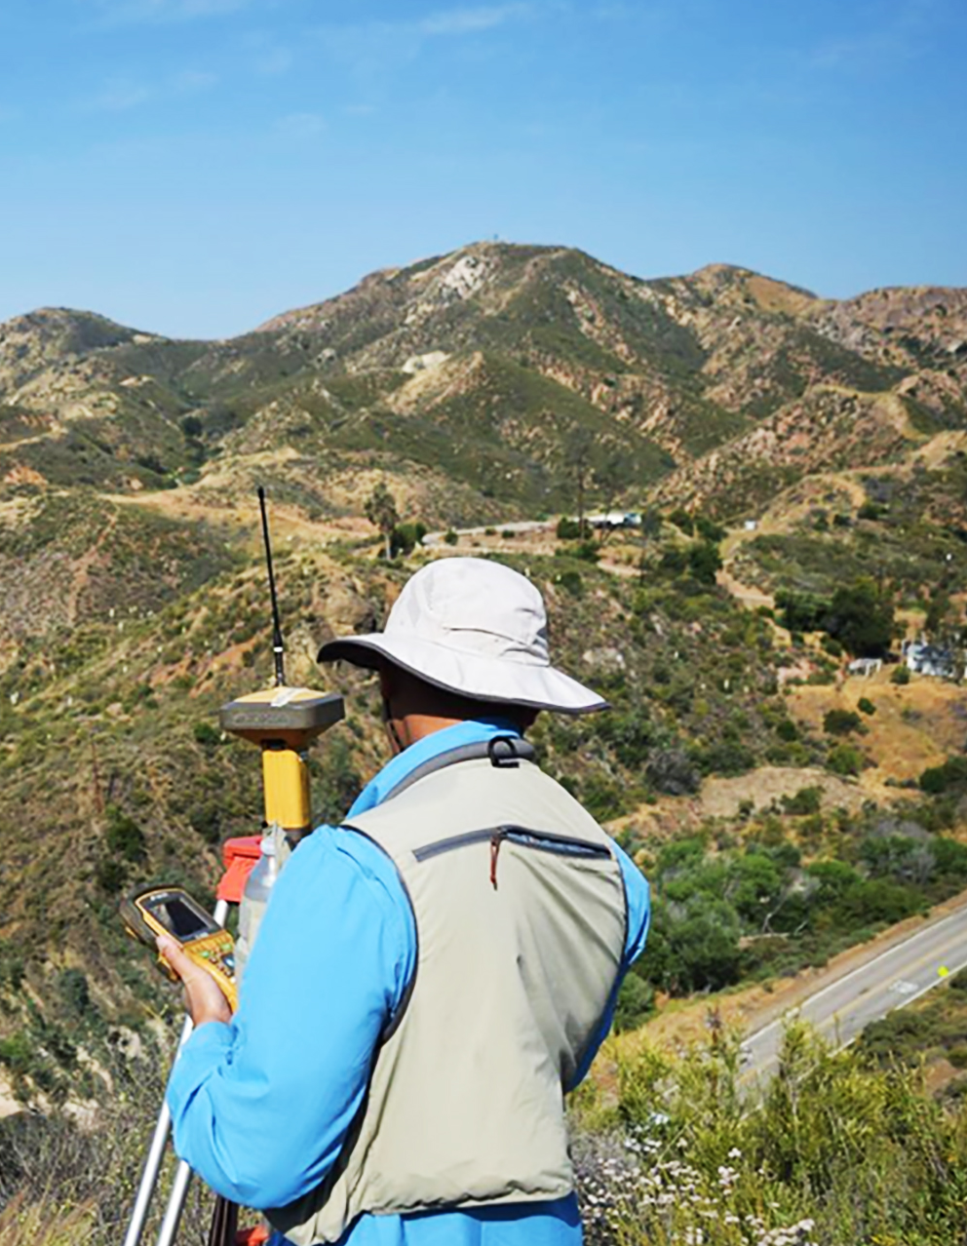
Grant Services We Offer
High-Quality Grant Application Writing
Technical Editing
Custom Graphics
Technical Expertise
Technically Sound Grant Narratives
Accurate Budgets and Cost Estimates
In-Kind Matching Funds
We can contribute to your matching funds goal!

Slide 6
Example Grant Services Project: NC-24 Living Shoreline
Project Partners Include:
North Carolina Department of Transportation
North Carolina Coastal Federation
Prepared Successful Grant Application
Awarded $2.7M Grant:
Design and Implementation of a Living Shoreline along N.C. State Highway 24.
Over $2.8M in Matching Funds
Total project value of $5.6M
FEDERAL MARKET / GRANT SERVICES OVERVIEW

Slide 7
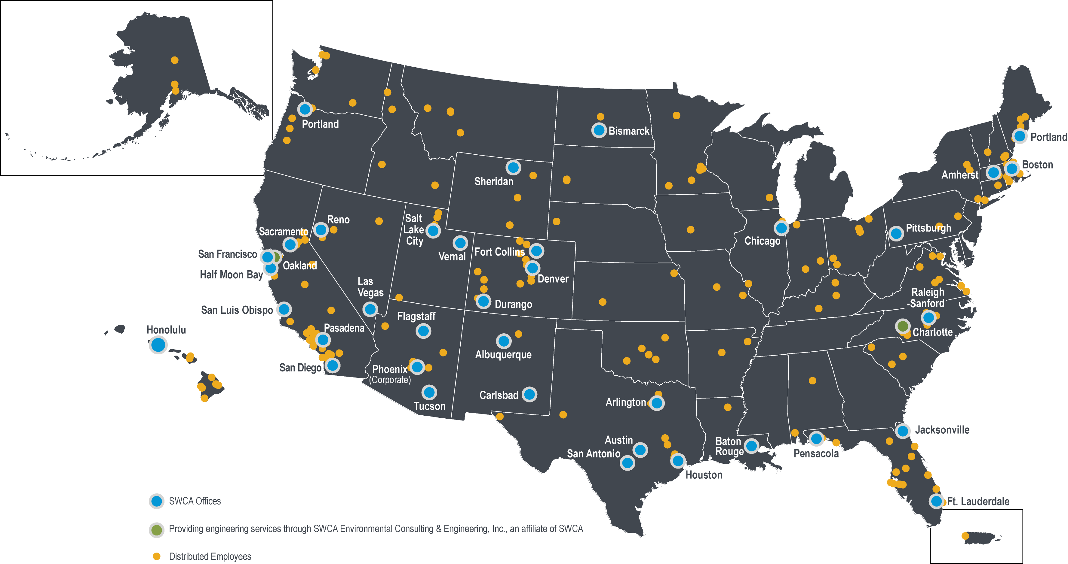
office locations

